Slide 1


PSYCHOLOGY
Chapter 7 THINKING AND INTELLIGENCE
PowerPoint Image Slideshow

Slide 2
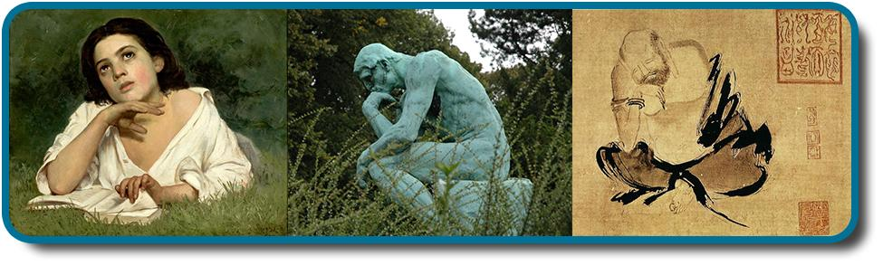
COGNITIVE PSYCHOLOGY
Cognition, most simply, is thinking. It encompasses the processes associated with:
Perception
Knowledge
Problem-solving
Judgement
Language
Memory
Figure 7.1 The 19th-century Girl with a Book by José Ferraz de Almeida Júnior, the 20th-century sculpture The Thinker by August Rodin, and Shi Ke’s 10th-century painting Huike Thinking all reflect the fascination with the process of human thought. (credit “middle”: modification of work by Jason Rogers; credit “right”: modification of work by Tang Zu-Ming)

Slide 3
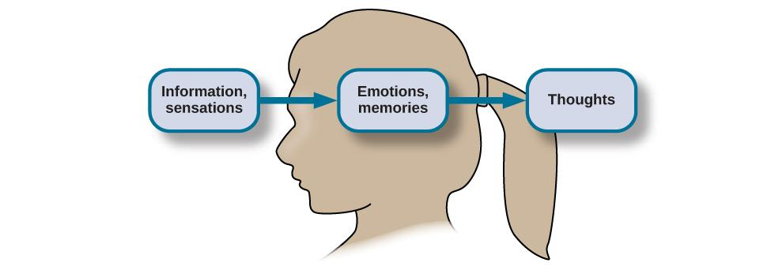
COGNITION
Figure 7.2
Sensations and information are received by our brains, filtered through emotions and memories, and processed to become thoughts.

Slide 4
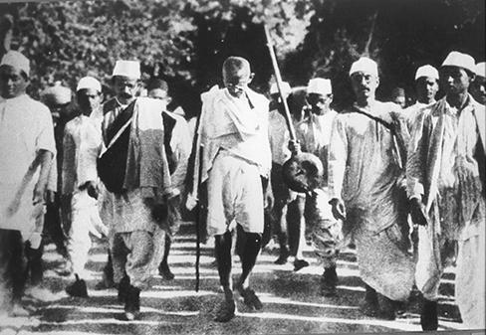
CONCEPTS & PROTOTYPES
How does the brain organize information?
Concepts – categories of linguistic information, images, ideas, or memories.
Used to see relationships among different elements of experience.
Can be complex and abstract (e.g. the idea of justice) or concrete (types of birds).
Prototype – the best example or representation of a concept.
E.g. Mahatma Gandhi could be a prototype for the category of civil disobedience.
In 1930, Mohandas Gandhi led a group in peaceful protest against a British tax on salt in India.
Figure 7.3

Slide 5
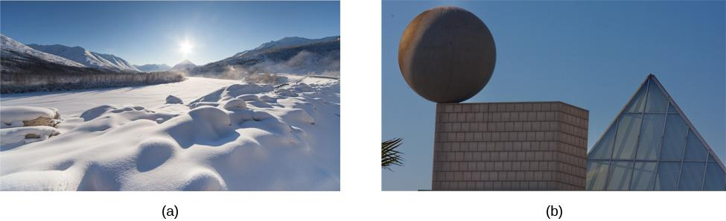
NATURAL & ARTIFICIAL CONCEPTS
Natural concepts:
Created “naturally” through either direct or indirect experience.
E.g. our concept of snow.
Artificial concepts:
Defined by a specific set of characteristics.
E.g. Properties of geometric shapes (squares, triangles etc).
Figure 7.4 (credit a: modification of work by Maarten Takens; credit b: modification of work by “Shayan (USA)”/Flickr)

Slide 6
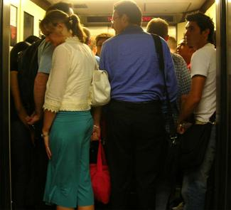
SCHEMATA
Schema – a mental construct consisting of a collection of related concepts.
When a schema is activated, we automatically make assumptions about the person/object/situation.
Role schema – makes assumptions about how individuals in certain roles will behave.
What assumptions come to mind about a librarian?
Event schema (cognitive script) – a set of routine or automatic behaviors.
Can vary widely among different cultures and countries.
Dictate behavior.
Make habits difficult to break.
E.g. when riding in an elevator, we automatically stand facing the door.
Figure 7.5 (credit: “Gideon”/Flickr)

Slide 7

EVENT SCHEMA
Event schemas are difficult to change because they are automatic.
When we receive a text, our event schema is to pick up our phone and reply. The problem is that this automatic reaction will arise even in situations when it is not safe to reply.
Texting while driving is dangerous, but it is a difficult event schema for some people to resist.
Research suggests that just the event schema of regularly checking our phone makes it increasingly difficult to resist picking it up while driving.
Figure 7.6

Slide 8
LANGUAGE
Language – a communication system that involves using words and systematic rules to organize those words to transmit information from one individual to another.
Components of Language
Lexicon – the words of a given language.
Grammar – the set of rules that are used to convey meaning through the use of the lexicon.
Phoneme – a basic sound unit (ah, eh,).
Morphemes – the smallest units of language that convey some type of meaning.
Language is constructed through semantics and syntax.
Semantics – the meaning we derive from morphemes and words.
Syntax – the way words are organized into sentences.

Slide 9
LANGUAGE DEVELOPMENT
Noam Chomsky – proposed that the mechanisms underlying language acquisition are biologically determined.
Language develops in the absence of formal instruction.
Language acquisition follows similar patterns in children from different cultures/backgrounds.
Critical period – proficiency at acquiring language is maximal early in life.
Being deprived of language during the critical period impedes the ability to fully acquire and use language.
The Case of Genie
The effects of language deprivation during the critical period can be seen in the case study of Genie.
Was found at age 13 after being raised in neglectful and abusive conditions.
Grew up with virtually no social interaction and was unable to speak when found.
With help, Genie was able to acquire vocabulary but was not able to learn the grammatical aspects of language.

Slide 10
PROBLEM SOLVING STRATEGIES
Trial and error – continue trying different solutions until problem is solved.
Algorithm – step-by-step problem-solving formula.
Heuristic – general problem-solving framework.
Short-cuts.
A “rule of thumb”.
Working-backwards – begin solving the problem by focusing on the end result.
Breaking large tasks into a series of smaller steps.
When do people use heuristics?
When one is faced with too much information.
When the time to make a decision is limited.
When the decision to be made is unimportant.
When there is access to very little information to use in making the decision.
When an appropriate heuristic happens to come to mind in the same moment.

Slide 11
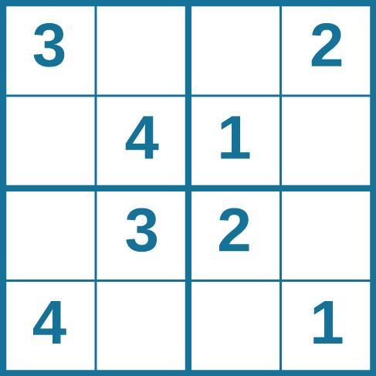
PUZZLE 1: SUDOKU
Problem solving abilities can improve with practice. Many people practice everyday with puzzles such as sudoku.
Figure 7.8

Slide 12
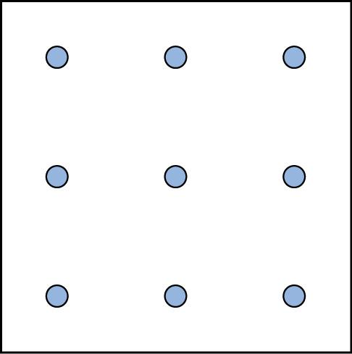
PUZZLE 2: SPATIAL REASONING
Connect all nine dots with four connecting straight lines without lifting your pencil from the paper.
Figure 7.9

Slide 13
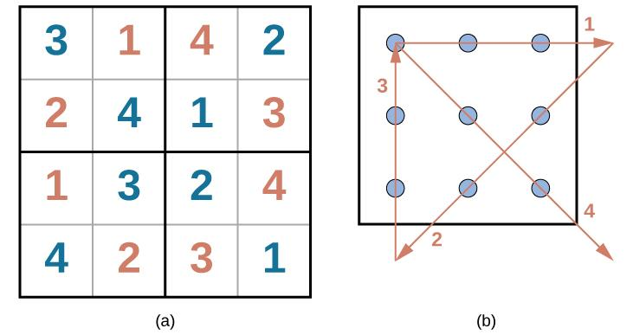
ANSWERS
Figure 7.11

Slide 14
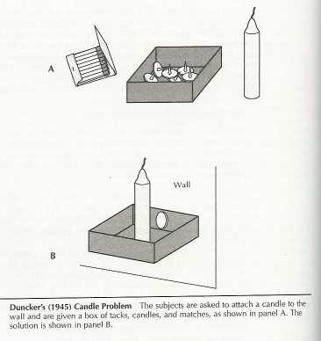
PITFALLS TO PROBLEM SOLVING
“Insanity is doing the same thing over and over again and expecting a different result” – Albert Einstein.
Mental sets
Persistence in approaching a problem in a way that has worked in the past. (A set way of looking at a problem).
Becomes a problem when that way is no longer working.
Functional fixedness – inability to perceive an object being used for something other than what it was designed for.
Imagine you have a candle, thumbtacks and a box of matches. You need to mount the candle on the wall and light it. What do you do?
Very few people think to use the box as a holder for the candle which can be tacked to the wall because they are fixated on its normal function.
(Credit: wikepedia)

Slide 15
BIASES
Knowledge and reasoning are used to make decisions. However, sometimes our ability to reason can be swayed by biases.
Anchoring bias – tendency to focus on one piece of information when making a decision or solving a problem.
Confirmation bias – tendency to focus on information that confirms your existing beliefs.
Hindsight bias – leads you to believe that the event you just experienced was predictable, even though it wasn’t.
Representative bias – tendency to unintentionally stereotype someone or something.
Availability heuristic – tendency to make a decision based on an example, information, or recent experience that is readily available to you, even though it may not be the best example to inform your decision.

Slide 16
CLASSIFYING INTELLIGENCE
What is intelligence?
Psychologists have come up with many different ways to define intelligence.
Charles Spearman
Believed intelligence consisted of one general factor, called g.
Focused on commonalities amongst various intellectual abilities.
Raymond Cattell
Divided intelligence into two components.
Crystalized intelligence – acquired knowledge and the ability to retrieve it.
Knowing facts.
Fluid intelligence – the ability to see complex relationships and solve problems.
Knowing how to do something.

Slide 17
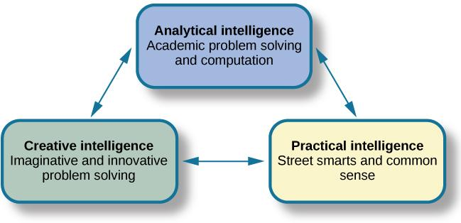
TRIARCHIC THEORY OF INTELLIGENCE
Robert Sternberg’s theory identifies three types of intelligence: practical, creative, and analytical.
Figure 7.12

Slide 18
MULTIPLE INTELLIGENCES THEORY
Howard Gardner proposed that each person possesses at least 8 intelligences.
Linguistic
Logical-mathematical
Musical
Bodily kinesthetic
Spatial
Interpersonal
Intrapersonal
Naturalist
Inter and intrapersonal intelligences are often combined and called emotional intelligence.
Emotional intelligence – the ability to understand the emotions of yourself and others, show empathy, understand social relationships and cues, and regulate your own emotions and respond in culturally appropriate ways.

Slide 19
CREATIVITY
Creativity – the ability to generate, create, or discover new ideas, solutions, and possibilities.
Creative people usually:
Have intense knowledge about something.
Work on it for years.
Look at novel solutions.
Seek out the advice and help of other experts.
Take risks.
Creativity is often thought of as ones ability to engage in divergent thinking.
Divergent thinking – thinking “outside the box”.
- Used when more than one possibility exists on a situation.
Convergent thinking – ability to provide a correct or well-established answer or solution to a problem.

Slide 20
MEASURES OF INTELLIGENCE
Measuring intelligence can come in many forms.
A person’s Intelligence quotient (IQ) is a score earned on a test designed to measure intelligence.
How do psychologists ensure that tests function as valid measures of intelligence?
The Stanford-Binet Intelligence Scale
Early 1900’s – Alfred Binet developed an intelligence test to use on children to determine which ones might have difficulty in school.
Louis Terman (a Stanford psychologist) modified Binet’s work by standardizing the administration of the test and testing thousands of children to establish a norm.
Standardization – the manner of administration, scoring, and interpretation of results is consistent.
Norming – giving a test to a large population so data can be collected comparing groups, such as age groups.
The resulting data provide norms/referential scores used to interpret future scores.
Standardization and norming ensure that new scores are reliable.

Slide 21
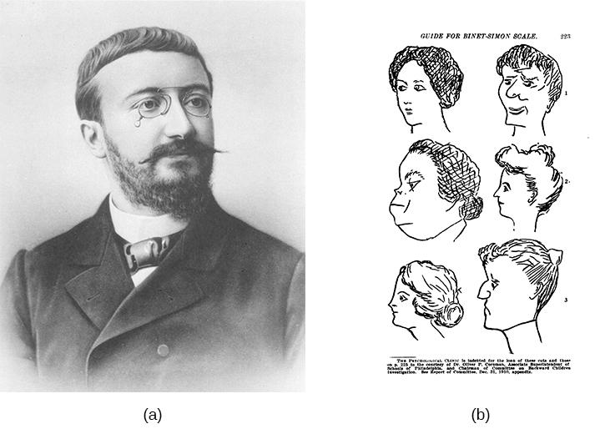
ALFRED BINET
Figure 7.13
French psychologist Alfred Binet helped to develop intelligence testing. (b) This page is from a 1908 version of the Binet-Simon Intelligence Scale. Children being tested were asked which face, of each pair, was prettier.

Slide 22
MEASURES OF INTELLIGENCE
Wechsler Adult Intelligence Scale (WAIS)
David Wechsler’s definition of intelligence - ”the global capacity of a person to act purposefully, to think rationally, and to deal effectively with his environment.”
In 1939, Wechsler developed a new IQ test by combining several subtests from other intelligence tests.
Tapped into a variety of verbal and nonverbal skills.
One of the most extensively used intelligence tests.
Wechsler Intelligence Scale for Children (WISC-V) is one of many versions used today that tests 1) verbal comprehension, 2) visual spatial, 3) fluid reasoning, 4) working memory and 5) processing Speed.
Flynn Effect
After years of use within schools and communities, periodic recalibration of WAIS lead to an observation known as the Flynn effect.
The observation that each generation has a significantly higher IQ than the last.

Slide 23
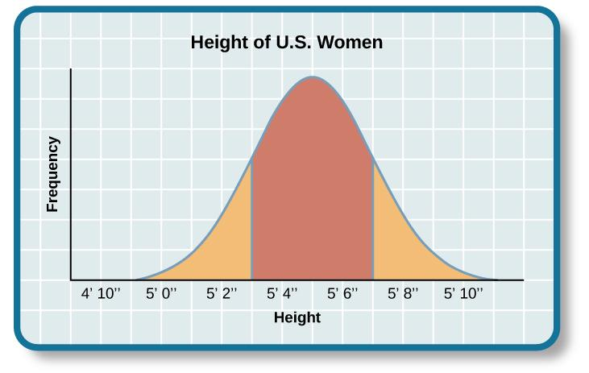
THE BELL CURVE
Results of intelligence tests follow the bell curve.
In psychological testing, this graph demonstrates a representative sample/normal distribution of a trait in the human population.
Representative sample – a subset of the population that accurately represents the general population.
Usually requires a large sample size.
Figure 7.14 Are you of below-average, average, or above-average height?

Slide 24
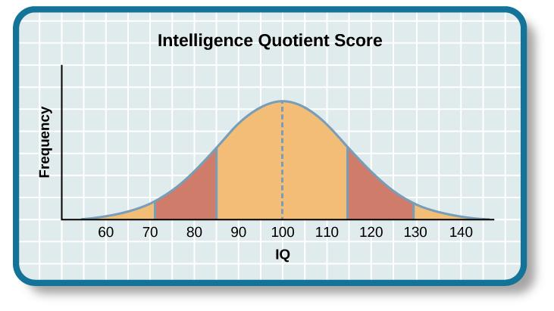
IQ BELL CURVE
The average IQ score is 100.
Standard deviations – describe how data are dispersed in a population.
One standard deviation in IQ testing is 15 points.
A score of 85 is one standard deviation below the mean (average).
Any score between one standard deviation above and below the mean is considered and average.
82% of the population have an IQ score between 85 and 115.
Figure 7.15

Slide 25
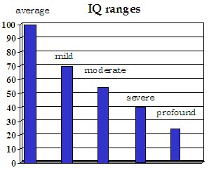
INTELLECTUAL DISABILITY
2.2% of the population has an IQ score below 70 and are considered intellectually disabled.
Exhibit deficits in intellectual functioning and adaptive behavior.
Formerly known as mental retardation.
The 4 subtypes are mild, moderate, severe and profound.
(Credit: National Institute of Health)

Slide 26
THE SOURCE OF INTELLIGENCE
Nature or Nurture?
Nature perspective – intelligence is inherited from a person’s parents.
The heritability of intelligence is often researched using twin studies.
Identical twins raised together and identical twins raised apart exhibit a higher correlation between IQ scores than siblings or fraternal twins raised together.
Nurture perspective – intelligence is shaped by a child’s developmental environment.
If parents present children with intellectual stimuli it will be reflected in the child’s intelligence level.
Most psychologists now believe levels of intelligence are a combination of both.
Range of reaction
Theory that each person responds to the environment in a unique way based on his or her genetic makeup.
Genetic makeup is a fixed quantity.
Whether you reach your full intellectual potential is dependent upon environmental factors.

Slide 27
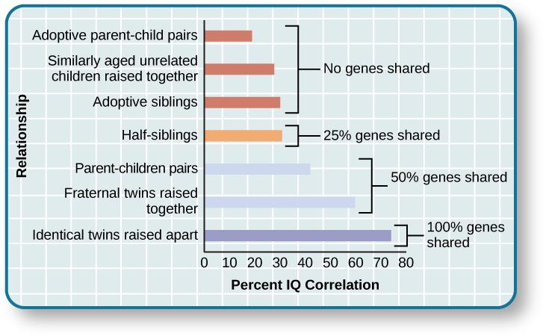
GENETICS AND IQ
Figure 7.16
The correlations of IQs of unrelated versus related persons reared apart or together suggest a genetic component to intelligence.

Slide 28
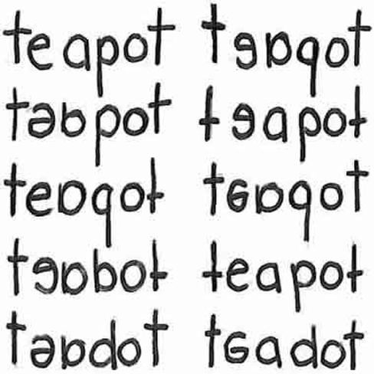
LEARNING DISABILITIES
Learning disabilities are cognitive disorders that affect different areas of cognition, particularly language or reading.
Specific neurological impairments, not an intellectual/developmental problem.
Often affect children with average to above-average intelligence.
Exhibit comorbidity with other disorders.
Dysgraphia
A learning disability resulting in a struggle to write legibly.
Have difficulty putting their thoughts down on paper.
Dyslexia
An inability to correctly process letters.
Most common learning disability in children.
May mix up letters within words and sentences (letter reversals).
Figure 7.17 These written words show variations of the word “teapot” as written by individuals with dyslexia.

